Slide 1
Instructions:
Print page 2
Fold page in half
Trim edges
Laminate
Send any updates to:
info@mypatrolbase.com.
Thanks.

Slide 2
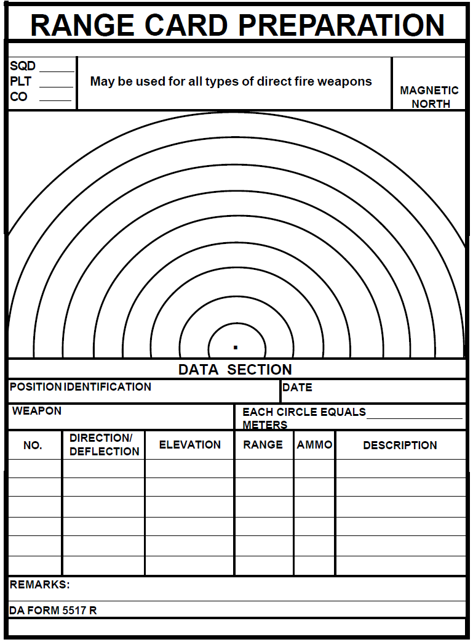
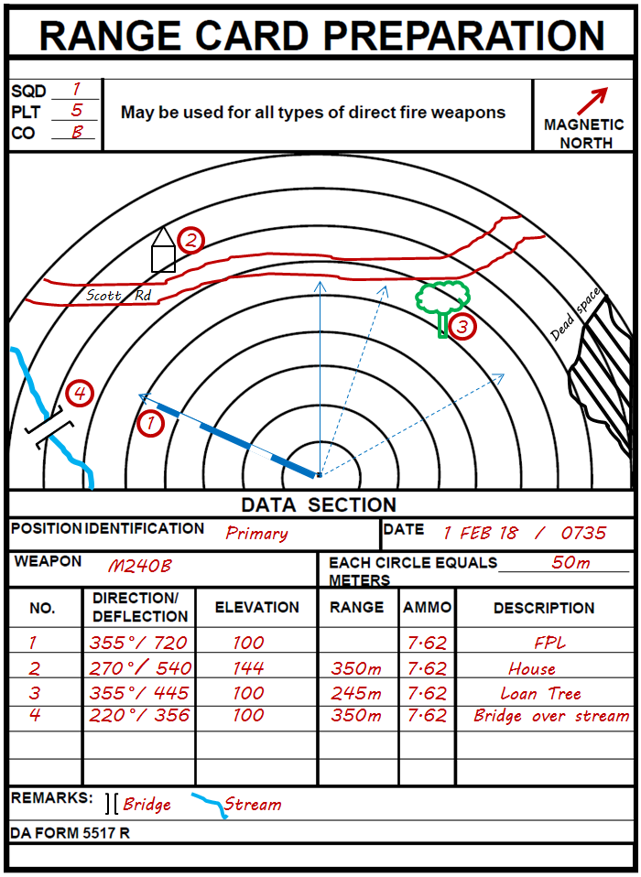
Number is always the FPL (Final Protective Line).
Bold line is for FPL & gaps indicate dead spaces.
Deflection & Elevation are traverse & elevation #’s on T&E.
Primary Sectors of Fire
Alternate Sectors of Fire
Color doesn’t matter.
1
MyPatrolBase.com

Slide 3
1
5
B
You can edit the example here and replace the screenshot of it on Page 2 with your update.
2
Scott Rd
Dead space
3
4
1
Primary 1 FEB 18 / 0735
M240B
50m
355 °/ 720 100 7.62 FPL
270 °/ 540 144 350m 7.62 House
355 °/ 445 100 245m 7.62 Loan Tree
220 °/ 356 100 350m 7.62 Bridge over stream
Bridge Stream

