Slide 1
Instructions for best results:
Print one slide per 8.5” x 11” sheet of paper. Don’t double-side.*
Laminate.
Punch a hole in the top corner of each sheet & connect with a loose-leaf binder ring.
Delete this page before printing.
Send any updates to: info@mypatrolbase.com. Thanks.
*Note: double-siding or spiral-binding OPORD will hinder Soldiers from working on different sections simultaneously.

Slide 2
WARNO________ (write in OPORD or included WARNO shell)
Fill in the info you need to get troops moving, balancing not holding info back with the need to get the WARNO out.
Always brief off map when relevant
Generally at a minimum fill in on this template:
  Task Org
  Mission
  We are here and the OBJ is here on the map
  Timeline (OPORD time & hit time minimum)
  Non-tactical & tactical tasks in Task to Subordinate Units
  Preparation Guidance
  Rehearsal Guidance
  Focus on big picture
  Use the map and other visuals.
Brief off the Map

Slide 3
WARNO ____ TO OPORD _______________
1) Who (Task Org/Tab A) 2) What are we doing (Concept of Op One Level Up 3) Enemy (Situation paragraph on Enemy)
Page 1 of 2
Initial Task Org:
Effective:
1. SITUATION: Enemy Overview (capabilities, etc.):
AI - Orient (N,S,E,W) & Box:
North: East:
South: West:
Who, What Where we are fighting:
AO - Trace boundaries & Familiarize w 3 natural and man-made features:
OBJ is here:_______________ We are here:_______________
___ Mission:
___ CDR’s Intent (Purpose):
___ Mission:
___ CDR’s Intent (Purpose):
2. MISSION:
READ TWICE
Taken from Tasks to Subordinate Units, Timeline, & Higher’s Purpose.
3. EXECUTION:
Recon to initiate
Recon Team:
Movement Instructions/Movement to initiate:
Our Current Location: ______________
Our Next Location: ________________
Objective Location: ________________
Information Requirements

Slide 4
WARNO ____ TO OPORD _______________
Page 2 of 2:
COORD INSTRUCTIONS:
Tactical and Non-Tactical Tasks: _______________________
_____________________________________________________________________________________________________________________________________________________________________________________________________________________________________________________
CCIR (info needed to create COA)
PIR: _______________
___________________
___________________
FFIR: (tells what FFs can do)
__________________________
__________________________
Priorities of Work / Priorities of Rehearsal:
Initial Operational / Planning timeline:
HIGHER
OUR PLANNING / OPERATIONAL
ENEMY
WX / LIGHT DATA
4. LOGISTICS:
Planning/preparation instructions
CTCP Grid: ________
Special Equipment, Trans, What to Prep
CLASS I: ____________
UMCP Grid: ________
CLASS III: ____________
LRP Grid: ________
CLASS IV: ____________
AXP Grid: ________
CLASS V: ____________
CCP Grid: ________
MCP Grid: ________
5. Command & Control::
Succession of Command: _______________________________
TOC Grid: ______________

Slide 5
OPORD__________
Take out pencil/pen, paper, RHB, map, protractor. Leader’s monitor subordinates.
Time now is _________
Roll Call:
Please hold all question until the end
Map & Charts: _____________________________________________________________________
Map series number (and country or geographic area, if required), sheet number and name, edition, and scale
References: Ranger Handbook, SQD/PLT SOPs, etc.: _____________________________________________________
Time Zone/s: _____________ For East Coast use Romeo (UTC-5/Eastern Standard Time). For multiple time zones use Zulu.
Task Organization:
(if too complex, show in an annex)
PL: ____________
PSG: ____________
WSL: ____________
1st SL: ____________ 2nd SL: ____________ 3rd SL: ____________
BTL: ____________ ATL: ____________
RTO: ____________ FO: ____________ Medic: ____________
T:
P:
T:
P:
T:
P:
T:
P:

Slide 6
GENERAL SITUATION
Venues
1. SITUATION
Always brief off terrain model, map, or concept sketch when relevant.

Slide 7
AREA OF INTEREST BY HOW ENEMY CAN ENGAGE US
Situation Con’t
 | SIZE & RANGE | LOCATION | TRIGGER | TIME | DEDUCTION
RWCAS
FWCAS
FA/ MTRS
RESERVES
OTHER

Slide 8
Venues
a. AREA OF INTEREST b. AREA OF OPERATIONS
Situation Con’t
(a) Orient (“This is N, S, E, W. A major city to the N is _______, a major city to the S is_______, etc.”)
N: ____________________________________
S: ____________________________________
E: ____________________________________
W: ____________________________________
(c) Trace (Actual AO boundaries: “To the east we have highway/grid line/river that intersects with Muddy River which forms our southern boundary.” Routes, Friendly Forces)
N: ____________________________________
S: ____________________________________
E: ____________________________________
W: ____________________________________
(b) Box (“Northing” and “Easting” Grid Lines, Named Roads, Phase Lines, Friendly Forces)
N: ____________________________________
S: ____________________________________
E: ____________________________________
W: ____________________________________
(d) Familiarize (3 manmade and 3 natural significant terrain features)
N: ____________________________________
S: ____________________________________
E: ____________________________________
W: ____________________________________
(e) Point
We are here: ___________________________
Our OBJ is here: _______________________
Notes:
8

Slide 9
Situation Con’t, Sect. b
TERRAIN
OAKOC- Effects on EN & FF
Deductions (So What?)
(Reference Overlay, Restricted, Unrestricted, Severely Restricted, how
does it affect movement)
Existing Reinforcing
Natural: Tactical:
Man Made: Protective:
Obstacles/Rough Terrain: (Green)
Benefits Enemy &
how we can counter it
Benefits Friendly
Avenues of Approach, surface, subsurface, supersurface (Blue) (Red)
AoA # Type/Comp Size (Mobility Corridor) Speed (Day/Night) Formation Dist/Dir
(Key Terrain Affords a Marked Advantage to Enemy/Friendly. Point to Map)
Key Terrain: (Purple)
KT1:
What Where (grid) Why/Effect
KT2:
KT3:
Observation and Fields of Fire:
Observation: where can EN/FF see each other
Field of Fire: areas that can be covered by a weapon system
Cover and Concealment:
(type of round, direct/indirect, structures, terrain)

Slide 10
Situation Con’t , Sect. b
WEATHER
Date | BMNT | Sunrise | Sunset | EENT | Moonrise | Moonset | Temp (High/Low) | Chance of Rain | Wind Speed & Dir
 | Enemy | Friendly | Deductions (So What?) | Favors
Cloud Cover | CAS, re-supply, extract, targeting | CAS, re-supply, extract, targeting
Precipitation % Chance: Type: | Movement, munitions | Movement, munitions
Temperature & Humidity High: Low: %: | Targeting (crossovers), personnel | Targeting (crossovers), personnel
Wind Knots: From: | Dust, air ops, comms, smoke | Dust, air ops, comms, smoke
Visibility, smoke, dust, fog, smog, sun in eyes? Distance: Illumination %: | NODs: | NODs: | NODs:

Slide 11
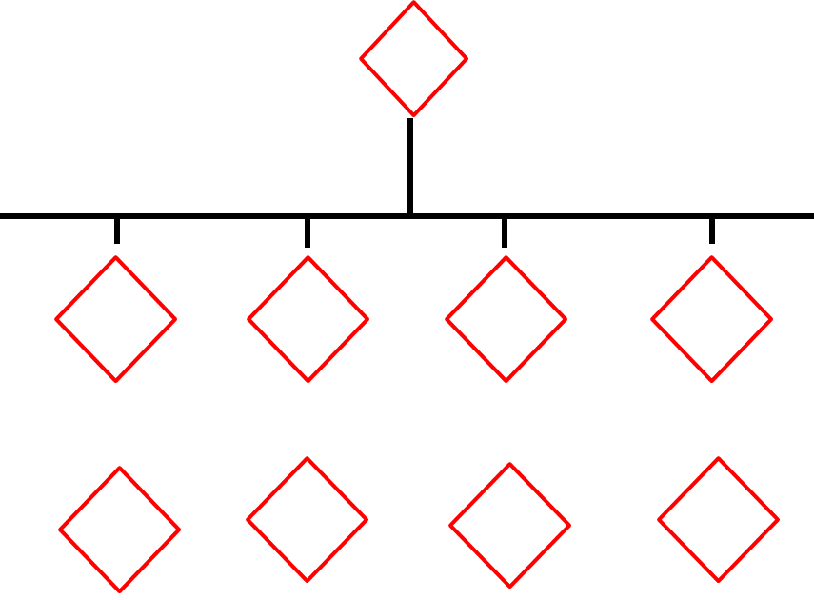
DO/ME
T:
P:
Location:
ENEMY FORCES
Situation Con’t , Sect. c
Taken from Para 1c of OPORD
COMPOSITION
DISPOSITION
SO1/SE1
T:
P:
Location:
SO2/SE2
T:
P:
Location:
SO3/SE3
T:
P:
Location:
Strength: ____%. Conventional/Unconventional
Civilian Support: _________
Moral: ______________
Capabilities (map), CAR-D (Close Air, Artillery, Reserves, & Defenses (known & suspected)) – how are we vulnerable & how to mitigate; how are they vulnerable: ________________________________________
________________________________________
________________________________________________________________________________________________________________________
________________________________________
Recent Activities (map): ____________________ ________________________________________________________________________________
Recent Activities con’t: ____________________________
________________________________________
________________________________________
________________________________________
SITTEMP (estimate on how enemy will fight): DRAW-D (Defend, Reinforce, Attack, Withdraw, Delay)
MLCoA (map), how does he normally fight: ______________
_________________________________________
_________________________________________
_________________________________________
MDCoA (map), what he is capable of doing that will through off yr CoA & yr countermeasures: _____________________________
_________________________________________
__________________________________________________________________________________
NOTE: For FRAGOs, tell how Enemy SOPs may have changed since operations against them began: quicker reactions, etc..

Slide 12
Situation Con’t , Sect. c
ASCOPE
Analysis: ASCOPE
DEDUCTIONS
Areas:
Clans/Ethnic/Religious, Pol., Financial, Residential, Industrial, Gang Territory
Benefits Enemy Benefits Friendly
Structures:
Worship Centers, TV, Radio, Print, Schools, Businesses, Power, Sanitation, Water
Capabilities: SWEAT-MS
Sewage Water Electricity
Academics Trash Medical Security
Organizations:
Business, Political, Refugee, Infrastructure, Criminal
People:
Leaders (Political & Religious), Professionals, Citizens, Refugees, Tribes
Events:
Markets, Holidays, Gatherings

Slide 13
Situation Con’t , Sect. c
ASCOPE/PMESII
 | P Political | M Military/Police | E Economic | S Social | I Information | I Infrastructure
A Areas | Political Areas: District Boundary, Party affiliation areas) | Mil. Police Areas - Coalition / LN bases, historic ambush/IED sites) | Economic Areas: bazaars, shops, markets | Social Areas: parks and other meeting areas | Info Areas: Radio/TV/newspapers /where people gather for word-of-mouth | Infrastructure Areas: Irrigation networks, water tables, medical coverage
S Structures | Political Structures: town halls, government offices | Mil/ Police Structures: police HQ, Military HHQ locations | Economic Structures: banks, markets, storage facilities | Social Structures: Churches, restaurants, bars, etc. | Info Structures: Cell / Radio / TV towers, print shops | Infrastructure Structures: roads, bridges, power lines, walls, dams
C Capabilities | Political Capabilities: Dispute resolution, Insurgent capabilities | Mil./Police Capabilities: security posture, strengths and weaknesses | Economic Capabilities: access to banks, ability to withstand natural disasters | Social Capabilities: Strength of local & national ties) | Info Capabilities: Literacy rate, availability of media / phone service | Infrastructure Capabilities: Ability to build / maintain roads, walls, dams
O Organizations | Political Organizations: Political parties and other power brokers, UN | Mil./Pol. Organizations: What units of military, police, insurgent are present | Economic Organizations: Banks, large land holders, big businesses | Social Organizations: tribes, clans, families, youth groups, NGOs / IGOs | Info Organizations: NEWS groups, influential people who pass word | Infrastructure Organizations: Gov ministries, construction companies
P People | Political People: Governors, councils, elders | Mil./Police People: Leaders from coalition, LN and insurgent forces | Economic People: Bankers, landholders, merchants | Social People: Religious leaders, influential families | Info People: Media owners, mullahs, heads of powerful families | Infrastructure People: Builders, contractors, development councils
E Events | Political Events: elections, council meetings | Mil./Pol. Events: lethal/nonlethal events, loss of leadership, operations, anniversaries | Economic Events: drought, harvest, business open/close | Social Events: holidays, weddings, religious days | Info Events: IO campaigns, project openings, CIVCAS events | Infrastructure Events: road/bridge construction, well digging, scheduled maintenance

Slide 14
FRIENDLY FORCES 2/1 UP
Situation Con’t , Sect. d
Info from paragraphs 1d, 2, and 3 of OPORD.
2 Levels Up Mission:
________________________________________________________________________________________________________________________________________________________________________________________________________________________________________________________________
2 Levels Up Intent:
________________________________________________________________________________________________________________________________________________________________________________________________________________________________________________________________
1 Level Up Mission:
________________________________________________________________________________________________________________________________________________________________________________________________________________________________________________________________
1 Level Up Intent:
________________________________________________________________________________________________________________________________________________________________________________________________________________________________________________________________
Mission of Adjacent Units (map): from para 3b(1): Execution, Concept of the Operation, Scheme of Movement and Maneuver
Attachments/Detachments: Try to put all in Task Org but otherwise, state here when they will be in effect if not from the start (“on order” or “on commitment of the reserve”). Use “remains attached” if will attached for some time.
DO/ME _____
T:
P:
Location:
How influences our mission if at all:
SO1/SE1_____
T:
P:
Location:
How influences our mission if at all:
SO2/SE2_____
T:
P:
Location:
How influences our mission if at all:
SO3/SE3_____
T:
P:
Location:
How influences our mission if at all:

Slide 15
2. MISSION
Our Mission: drawn from Para 3, Task to Subordinate Units &Tactical Tasks. Tells:
Who does What (Tasks to Sub. Units & Scheme of Man.), When (NLT DTG), Where (grid cord. & OBJ code name), & Why (purpose from Tasks to Subordinate Units, Timeline, & Higher’s Purpose)
________________________________________________________________________________________________________________________________________________________________________________________________________________________________________
READ TWICE: “I say again…”
Here is us and here is our OBJ on the map.

Slide 16
COMMANDER’S INTENT
3. EXECUTION, Sect. a
For Company Commanders and up: A clear, concise statement of what the force must do and conditions the force must
establish with respect to the enemy, terrain, and civil considerations that represent the desired end state.
________________________________________________________________________________________________________________________________________________________________________________________________________________________________________
_Purpose:_________________________________________________
__________________________________________________________
__________________________________________________________
_Key Tasks:________________________________________________
__________________________________________________________
__________________________________________________________
Conditions that Represent the End State
Friendly i.e.: 100% MWE and ready for follow-on missions
Enemy i.e.: all enemy destroyed in kill zone
Terrain i.e.: FOM for humanitarian relief efforts
Civilian Considerations i.e.: Minimum casualties & collateral damage to civilians and infrastructure

Slide 17
CONCEPT OF OPERATIONS / FRIENDLY CoA:
Execution Con’t, Sect. b
Purpose of the Operation is: _________________________________________________________________________________
  We will accomplish this by Form of Maneuver: ______________________________________________________________________
  Envelopment (secure obj. in rear), Flank (side) Attack, Frontal Attack, Infiltration (entering denied area), Penetration (disrupting enemy on narrow front), Turning Movement (forces E. to turn in to new direction to fight)
The Decisive Point of the Operation is: _________________________________________________________________________
The point at which we can’t loose.
This is Decisive Because: ___________________________________________________________________________________
We Accept Risk By: _________________________________________________________________________________________
We Mitigate Risk By: ________________________________________________________________________________________
CONOP: enables subordinate units to visualize how, when, and where their unit will contribute to mission accomplishment. It defines their essential tasks & purposes ,& tactical risks & mitigations. Most importantly, it tells the decisive point, why decisive, how the decisive operation (DO) will achieve it, and how each shaping operation’s (SO) purpose is nested to create conditions for DO.
DO/ME _____
T: __________
P: __________
SO1/SE1_____
T: __________
P: __________
SO2/SE2_____
T: __________
P: __________
SO3/SE3_____
T: __________
P: __________
Warfighting Functions
Purpose of Fires is: ________________________________________________________________________________________
Purpose of Movement and Maneuver is: _______________________________________________________________________
Purpose of Protection is: ____________________________________________________________________________________
Purpose of Mission Command is: ____________________________________________________________________________
Purpose of Intelligence is: ___________________________________________________________________________________
Purpose of Sustainment is: __________________________________________________________________________________
Purpose of Engagement is: __________________________________________________________________________________

Slide 18
FRIENDLY CONCEPT OF OPERATION
Execution Con’t, Sect. b
This will be a _____ Phase Operation
Typical Phases: Planning, Infil/Movement, Occupation, AoO, Withdrawal & Reconsolidation
PHASE | BEGINS | ENDS | (Distance, Direction, Time, Method of Movement) | KEY ACTIONS/OCOKA CONSIDERATIONS
1 |  |  | D: D: T: M:
2 |  |  | D: D: T: M:
3 |  |  | D: D: T: M:
4 |  |  | D: D: T: M:
5 |  |  | D: D: T: M:

Slide 19
FRIENDLY CONCEPT OF THE OPERATION CONT’D
Execution Con’t
Execution Con’t, Sect. b
PHASE | BEGINS | ENDS | (Distance, Direction, Time, Method of Movement) | KEY ACTIONS
6 |  |  | D: D: T: M:
7 |  |  | D: D: T: M:
8 |  |  | D: D: T: M:
9 |  |  | D: D: T: M:
10 |  |  | D: D: T: M:

Slide 20
CoA SKETCH
Execution Con’t
Execution Con’t, Sect. b

Slide 21
SCHEME OF MANEUVER
Execution Con’t, Sect. c
Phase: _______________ Begins: _________________ Ends: __________________ Critical to Phase: ___________________________________________________
Rehearsals: ______________________________________________________________________________________________________________________________________________________
Formation/Order of Movement:
______________________________________________________________________________________________________________________________________________________
PACE during Movement/React to Contact/LDAs (Day/Night):
P: __________/__________ A: __________/__________ C:__________/__________ E:__________/__________ Mission Decision Line / Decisive Point:_____________________________
Routes (VDOs, Distance, Direction, CPs, LDAs, ODAs, Key Terrain, Responsibilities) (ATL/SL)
Primary includes water resupply : (a Reconsolidation Point must be 2k or a major terrain feature away from OBJ): ___________________________________________________________________________________________________________________________________________________________________________________________________________________________________________________________________________________________________________________________________________________________________________________________________________________________________________________________________________________________________________________________
Alternate includes water resupply : (a Reconsolidation Point must be 2k or a major terrain feature away from OBJ): ___________________________________________________________________________________________________________________________________________________________________________________________________________________________________________________________________________________________________________________________________________________________________________________________________________________________________________________________________________________________________________________________
Key Tasks by Squads or Teams (VDOs, IRP, LDAs, ERPs, SH/LH, LU, ORP, RP, AOO/Responsibilities, Recon, Occupation, Engagement Criteria, Control Measures, C&R, Withdrawal Plan, Compromise Plan):
_____________________________________________________________________________________________________________________________________________________________________________________________________________________________________________________________________________________________________________________________________________________________________________________________________________________________________________________________________________________________________________________________________________________________________________________________________________________________________________________________________________________________________________________________________________________________________________________________________________________________________________________________________________
Direct Fire Control Plan: (PLs, TRPs, RFLs, NFAs)
______________________________________________________________________________________________________________________________________________________
Shift/Cease Fire (Day/Night)
P: __________/__________ A: __________/__________ C: __________/__________ E: __________/__________
SPARC
Sectors of Fire:__________ Priorities of Fire:__________ Assault Lanes:__________ Rates of Fire:__________ Camo
EWAC
Engagement:____________________ Withdraw:____________________ Abort:____________________ Compromise: Hard - ____________________ Soft - ____________________
Weapons Control Status: Hold – Tight - Free
C2 Locations/Succession of Command:_________________________________________________________________________________________________________________________________________________
Contingencies (RTC, IDF, Contact @ LDA, IED, Contact @ VDO):
__________________________________________________________________________________________________________________________________________________________________________________________________________________________________________________________________________________________________________________________________________________
OPSKED/Key Calls (RTO):
_________________________________________________________________________________________________________________________________________________________________________
Fire Support/Targets/CAS Support (FO): _________________________________________________________________________________________________________________________________________________________________________
Sustainment (PSG/BTL):
Location of PSG/BTL & Medic during this Phase:__________________________________________________________________________________________________________________________________
Locations of A&L Team/s, CCPs, BN Aid Station & their markings:____________________________________________________________________________________________________________________
_________________________________________________________________________________________________________________________________________________________________________
Method of Marking Patients:___________________________________________________________________________________________________________________________________________________
Casualty Care (Self Aid, Buddy Aid, TC3, Medic, FST):_________________________________________________________________________________________________________________________________
HLZs and AXPs:____________________________________________________________________________________________________________________________________________________________
Resupply/Speedballs:________________________________________________________________________________________________________________________________________________________

Slide 22
SCHEME OF MANEUVER
Execution Con’t, Sect. c
Phase: _______________ Begins: _________________ Ends: __________________ Critical to Phase: ___________________________________________________
Rehearsals: ______________________________________________________________________________________________________________________________________________________
Formation/Order of Movement:
______________________________________________________________________________________________________________________________________________________
PACE during Movement/React to Contact/LDAs (Day/Night):
P: __________/__________ A: __________/__________ C:__________/__________ E:__________/__________ Mission Decision Line / Decisive Point:_____________________________
Routes (VDOs, Distance, Direction, CPs, LDAs, ODAs, Key Terrain, Responsibilities) (ATL/SL)
Primary includes water resupply : (a Reconsolidation Point must be 2k or a major terrain feature away from OBJ): ___________________________________________________________________________________________________________________________________________________________________________________________________________________________________________________________________________________________________________________________________________________________________________________________________________________________________________________________________________________________________________________________
Alternate includes water resupply : (a Reconsolidation Point must be 2k or a major terrain feature away from OBJ): ___________________________________________________________________________________________________________________________________________________________________________________________________________________________________________________________________________________________________________________________________________________________________________________________________________________________________________________________________________________________________________________________
Key Tasks by Squads or Teams (VDOs, IRP, LDAs, ERPs, SH/LH, LU, ORP, RP, AOO/Responsibilities, Recon, Occupation, Engagement Criteria, Control Measures, C&R, Withdrawal Plan, Compromise Plan):
_____________________________________________________________________________________________________________________________________________________________________________________________________________________________________________________________________________________________________________________________________________________________________________________________________________________________________________________________________________________________________________________________________________________________________________________________________________________________________________________________________________________________________________________________________________________________________________________________________________________________________________________________________________
Direct Fire Control Plan: (PLs, TRPs, RFLs, NFAs)
______________________________________________________________________________________________________________________________________________________
Shift/Cease Fire (Day/Night)
P: __________/__________ A: __________/__________ C: __________/__________ E: __________/__________
SPARC
Sectors of Fire:__________ Priorities of Fire:__________ Assault Lanes:__________ Rates of Fire:__________ Camo
EWAC
Engagement:____________________ Withdraw:____________________ Abort:____________________ Compromise: Hard - ____________________ Soft - ____________________
Weapons Control Status: Hold – Tight - Free
C2 Locations/Succession of Command:_________________________________________________________________________________________________________________________________________________
Contingencies (RTC, IDF, Contact @ LDA, IED, Contact @ VDO):
__________________________________________________________________________________________________________________________________________________________________________________________________________________________________________________________________________________________________________________________________________________
OPSKED/Key Calls (RTO):
_________________________________________________________________________________________________________________________________________________________________________
Fire Support/Targets/CAS Support (FO): _________________________________________________________________________________________________________________________________________________________________________
Sustainment (PSG/BTL):
Location of PSG/BTL & Medic during this Phase:__________________________________________________________________________________________________________________________________
Locations of A&L Team/s, CCPs, BN Aid Station & their markings:____________________________________________________________________________________________________________________
_________________________________________________________________________________________________________________________________________________________________________
Method of Marking Patients:___________________________________________________________________________________________________________________________________________________
Casualty Care (Self Aid, Buddy Aid, TC3, Medic, FST):_________________________________________________________________________________________________________________________________
HLZs and AXPs:____________________________________________________________________________________________________________________________________________________________
Resupply/Speedballs:________________________________________________________________________________________________________________________________________________________

Slide 23
SCHEME OF MANEUVER
Execution Con’t, Sect. c
Phase: _______________ Begins: _________________ Ends: __________________ Critical to Phase: ___________________________________________________
Rehearsals: ______________________________________________________________________________________________________________________________________________________
Formation/Order of Movement:
______________________________________________________________________________________________________________________________________________________
PACE during Movement/React to Contact/LDAs (Day/Night):
P: __________/__________ A: __________/__________ C:__________/__________ E:__________/__________ Mission Decision Line / Decisive Point:_____________________________
Routes (VDOs, Distance, Direction, CPs, LDAs, ODAs, Key Terrain, Responsibilities) (ATL/SL)
Primary includes water resupply : (a Reconsolidation Point must be 2k or a major terrain feature away from OBJ): ___________________________________________________________________________________________________________________________________________________________________________________________________________________________________________________________________________________________________________________________________________________________________________________________________________________________________________________________________________________________________________________________
Alternate includes water resupply : (a Reconsolidation Point must be 2k or a major terrain feature away from OBJ): ___________________________________________________________________________________________________________________________________________________________________________________________________________________________________________________________________________________________________________________________________________________________________________________________________________________________________________________________________________________________________________________________
Key Tasks by Squads or Teams (VDOs, IRP, LDAs, ERPs, SH/LH, LU, ORP, RP, AOO/Responsibilities, Recon, Occupation, Engagement Criteria, Control Measures, C&R, Withdrawal Plan, Compromise Plan):
_____________________________________________________________________________________________________________________________________________________________________________________________________________________________________________________________________________________________________________________________________________________________________________________________________________________________________________________________________________________________________________________________________________________________________________________________________________________________________________________________________________________________________________________________________________________________________________________________________________________________________________________________________________
Direct Fire Control Plan: (PLs, TRPs, RFLs, NFAs)
______________________________________________________________________________________________________________________________________________________
Shift/Cease Fire (Day/Night)
P: __________/__________ A: __________/__________ C: __________/__________ E: __________/__________
SPARC
Sectors of Fire:__________ Priorities of Fire:__________ Assault Lanes:__________ Rates of Fire:__________ Camo
EWAC
Engagement:____________________ Withdraw:____________________ Abort:____________________ Compromise: Hard - ____________________ Soft - ____________________
Weapons Control Status: Hold – Tight - Free
C2 Locations/Succession of Command:_________________________________________________________________________________________________________________________________________________
Contingencies (RTC, IDF, Contact @ LDA, IED, Contact @ VDO):
__________________________________________________________________________________________________________________________________________________________________________________________________________________________________________________________________________________________________________________________________________________
OPSKED/Key Calls (RTO):
_________________________________________________________________________________________________________________________________________________________________________
Fire Support/Targets/CAS Support (FO): _________________________________________________________________________________________________________________________________________________________________________
Sustainment (PSG/BTL):
Location of PSG/BTL & Medic during this Phase:__________________________________________________________________________________________________________________________________
Locations of A&L Team/s, CCPs, BN Aid Station & their markings:____________________________________________________________________________________________________________________
_________________________________________________________________________________________________________________________________________________________________________
Method of Marking Patients:___________________________________________________________________________________________________________________________________________________
Casualty Care (Self Aid, Buddy Aid, TC3, Medic, FST):_________________________________________________________________________________________________________________________________
HLZs and AXPs:____________________________________________________________________________________________________________________________________________________________
Resupply/Speedballs:________________________________________________________________________________________________________________________________________________________

Slide 24
SCHEME OF MANEUVER
Execution Con’t, Sect. c
Phase: _______________ Begins: _________________ Ends: __________________ Critical to Phase: ___________________________________________________
Rehearsals: ______________________________________________________________________________________________________________________________________________________
Formation/Order of Movement:
______________________________________________________________________________________________________________________________________________________
PACE during Movement/React to Contact/LDAs (Day/Night):
P: __________/__________ A: __________/__________ C:__________/__________ E:__________/__________ Mission Decision Line / Decisive Point:_____________________________
Routes (VDOs, Distance, Direction, CPs, LDAs, ODAs, Key Terrain, Responsibilities) (ATL/SL)
Primary includes water resupply : (a Reconsolidation Point must be 2k or a major terrain feature away from OBJ): ___________________________________________________________________________________________________________________________________________________________________________________________________________________________________________________________________________________________________________________________________________________________________________________________________________________________________________________________________________________________________________________________
Alternate includes water resupply : (a Reconsolidation Point must be 2k or a major terrain feature away from OBJ): ___________________________________________________________________________________________________________________________________________________________________________________________________________________________________________________________________________________________________________________________________________________________________________________________________________________________________________________________________________________________________________________________
Key Tasks by Squads or Teams (VDOs, IRP, LDAs, ERPs, SH/LH, LU, ORP, RP, AOO/Responsibilities, Recon, Occupation, Engagement Criteria, Control Measures, C&R, Withdrawal Plan, Compromise Plan):
_____________________________________________________________________________________________________________________________________________________________________________________________________________________________________________________________________________________________________________________________________________________________________________________________________________________________________________________________________________________________________________________________________________________________________________________________________________________________________________________________________________________________________________________________________________________________________________________________________________________________________________________________________________
Direct Fire Control Plan: (PLs, TRPs, RFLs, NFAs)
______________________________________________________________________________________________________________________________________________________
Shift/Cease Fire (Day/Night)
P: __________/__________ A: __________/__________ C: __________/__________ E: __________/__________
SPARC
Sectors of Fire:__________ Priorities of Fire:__________ Assault Lanes:__________ Rates of Fire:__________ Camo
EWAC
Engagement:____________________ Withdraw:____________________ Abort:____________________ Compromise: Hard - ____________________ Soft - ____________________
Weapons Control Status: Hold – Tight - Free
C2 Locations/Succession of Command:_________________________________________________________________________________________________________________________________________________
Contingencies (RTC, IDF, Contact @ LDA, IED, Contact @ VDO):
__________________________________________________________________________________________________________________________________________________________________________________________________________________________________________________________________________________________________________________________________________________
OPSKED/Key Calls (RTO):
_________________________________________________________________________________________________________________________________________________________________________
Fire Support/Targets/CAS Support (FO): _________________________________________________________________________________________________________________________________________________________________________
Sustainment (PSG/BTL):
Location of PSG/BTL & Medic during this Phase:__________________________________________________________________________________________________________________________________
Locations of A&L Team/s, CCPs, BN Aid Station & their markings:____________________________________________________________________________________________________________________
_________________________________________________________________________________________________________________________________________________________________________
Method of Marking Patients:___________________________________________________________________________________________________________________________________________________
Casualty Care (Self Aid, Buddy Aid, TC3, Medic, FST):_________________________________________________________________________________________________________________________________
HLZs and AXPs:____________________________________________________________________________________________________________________________________________________________
Resupply/Speedballs:________________________________________________________________________________________________________________________________________________________

Slide 25
SCHEME OF MANEUVER
Execution Con’t, Sect. c
Phase: _______________ Begins: _________________ Ends: __________________ Critical to Phase: ___________________________________________________
Rehearsals: ______________________________________________________________________________________________________________________________________________________
Formation/Order of Movement:
______________________________________________________________________________________________________________________________________________________
PACE during Movement/React to Contact/LDAs (Day/Night):
P: __________/__________ A: __________/__________ C:__________/__________ E:__________/__________ Mission Decision Line / Decisive Point:_____________________________
Routes (VDOs, Distance, Direction, CPs, LDAs, ODAs, Key Terrain, Responsibilities) (ATL/SL)
Primary includes water resupply : (a Reconsolidation Point must be 2k or a major terrain feature away from OBJ): ___________________________________________________________________________________________________________________________________________________________________________________________________________________________________________________________________________________________________________________________________________________________________________________________________________________________________________________________________________________________________________________________
Alternate includes water resupply : (a Reconsolidation Point must be 2k or a major terrain feature away from OBJ): ___________________________________________________________________________________________________________________________________________________________________________________________________________________________________________________________________________________________________________________________________________________________________________________________________________________________________________________________________________________________________________________________
Key Tasks by Squads or Teams (VDOs, IRP, LDAs, ERPs, SH/LH, LU, ORP, RP, AOO/Responsibilities, Recon, Occupation, Engagement Criteria, Control Measures, C&R, Withdrawal Plan, Compromise Plan):
_____________________________________________________________________________________________________________________________________________________________________________________________________________________________________________________________________________________________________________________________________________________________________________________________________________________________________________________________________________________________________________________________________________________________________________________________________________________________________________________________________________________________________________________________________________________________________________________________________________________________________________________________________________
Direct Fire Control Plan: (PLs, TRPs, RFLs, NFAs)
______________________________________________________________________________________________________________________________________________________
Shift/Cease Fire (Day/Night)
P: __________/__________ A: __________/__________ C: __________/__________ E: __________/__________
SPARC
Sectors of Fire:__________ Priorities of Fire:__________ Assault Lanes:__________ Rates of Fire:__________ Camo
EWAC
Engagement:____________________ Withdraw:____________________ Abort:____________________ Compromise: Hard - ____________________ Soft - ____________________
Weapons Control Status: Hold – Tight - Free
C2 Locations/Succession of Command:_________________________________________________________________________________________________________________________________________________
Contingencies (RTC, IDF, Contact @ LDA, IED, Contact @ VDO):
__________________________________________________________________________________________________________________________________________________________________________________________________________________________________________________________________________________________________________________________________________________
OPSKED/Key Calls (RTO):
_________________________________________________________________________________________________________________________________________________________________________
Fire Support/Targets/CAS Support (FO): _________________________________________________________________________________________________________________________________________________________________________
Sustainment (PSG/BTL):
Location of PSG/BTL & Medic during this Phase:__________________________________________________________________________________________________________________________________
Locations of A&L Team/s, CCPs, BN Aid Station & their markings:____________________________________________________________________________________________________________________
_________________________________________________________________________________________________________________________________________________________________________
Method of Marking Patients:___________________________________________________________________________________________________________________________________________________
Casualty Care (Self Aid, Buddy Aid, TC3, Medic, FST):_________________________________________________________________________________________________________________________________
HLZs and AXPs:____________________________________________________________________________________________________________________________________________________________
Resupply/Speedballs:________________________________________________________________________________________________________________________________________________________

Slide 26
SCHEME OF MANEUVER
Execution Con’t, Sect. c
Phase: _______________ Begins: _________________ Ends: __________________ Critical to Phase: ___________________________________________________
Rehearsals: ______________________________________________________________________________________________________________________________________________________
Formation/Order of Movement:
______________________________________________________________________________________________________________________________________________________
PACE during Movement/React to Contact/LDAs (Day/Night):
P: __________/__________ A: __________/__________ C:__________/__________ E:__________/__________ Mission Decision Line / Decisive Point:_____________________________
Routes (VDOs, Distance, Direction, CPs, LDAs, ODAs, Key Terrain, Responsibilities) (ATL/SL)
Primary includes water resupply : (a Reconsolidation Point must be 2k or a major terrain feature away from OBJ): ___________________________________________________________________________________________________________________________________________________________________________________________________________________________________________________________________________________________________________________________________________________________________________________________________________________________________________________________________________________________________________________________
Alternate includes water resupply : (a Reconsolidation Point must be 2k or a major terrain feature away from OBJ): ___________________________________________________________________________________________________________________________________________________________________________________________________________________________________________________________________________________________________________________________________________________________________________________________________________________________________________________________________________________________________________________________
Key Tasks by Squads or Teams (VDOs, IRP, LDAs, ERPs, SH/LH, LU, ORP, RP, AOO/Responsibilities, Recon, Occupation, Engagement Criteria, Control Measures, C&R, Withdrawal Plan, Compromise Plan):
_____________________________________________________________________________________________________________________________________________________________________________________________________________________________________________________________________________________________________________________________________________________________________________________________________________________________________________________________________________________________________________________________________________________________________________________________________________________________________________________________________________________________________________________________________________________________________________________________________________________________________________________________________________
Direct Fire Control Plan: (PLs, TRPs, RFLs, NFAs)
______________________________________________________________________________________________________________________________________________________
Shift/Cease Fire (Day/Night)
P: __________/__________ A: __________/__________ C: __________/__________ E: __________/__________
SPARC
Sectors of Fire:__________ Priorities of Fire:__________ Assault Lanes:__________ Rates of Fire:__________ Camo
EWAC
Engagement:____________________ Withdraw:____________________ Abort:____________________ Compromise: Hard - ____________________ Soft - ____________________
Weapons Control Status: Hold – Tight - Free
C2 Locations/Succession of Command:_________________________________________________________________________________________________________________________________________________
Contingencies (RTC, IDF, Contact @ LDA, IED, Contact @ VDO):
__________________________________________________________________________________________________________________________________________________________________________________________________________________________________________________________________________________________________________________________________________________
OPSKED/Key Calls (RTO):
_________________________________________________________________________________________________________________________________________________________________________
Fire Support/Targets/CAS Support (FO): _________________________________________________________________________________________________________________________________________________________________________
Sustainment (PSG/BTL):
Location of PSG/BTL & Medic during this Phase:__________________________________________________________________________________________________________________________________
Locations of A&L Team/s, CCPs, BN Aid Station & their markings:____________________________________________________________________________________________________________________
_________________________________________________________________________________________________________________________________________________________________________
Method of Marking Patients:___________________________________________________________________________________________________________________________________________________
Casualty Care (Self Aid, Buddy Aid, TC3, Medic, FST):_________________________________________________________________________________________________________________________________
HLZs and AXPs:____________________________________________________________________________________________________________________________________________________________
Resupply/Speedballs:________________________________________________________________________________________________________________________________________________________

Slide 27
TTPs TO BRIEF
Execution Con’t
LDA Crossings
  Deliberate
  Hasty
React to Contact
  Near
  Far
IDF
Casualty Carriers
Common Terms:
  EWAC/CAATT, SPARC, COW-T & MWE
  Other:

Slide 28
SCHEME OF FIRES (BRIEFED DURING SOM): PLOT-CR & TTLODAC VERSIONS
Execution Con’t
Execution Con’t, Sect. d
Phase & Who has Priorities of Fires | Target # issued by Higher | Purpose | Location | Observer Primary & Alternate | Trigger Event triggering call | Comms Method | Resource Rnd by # & type, Fuse, Method of engagement/Limitations
 |  |  |  | P) A) | P) A) | P) A) | P) A)
 |  |  |  | P) A) | P) A) | P) A) | P) A)
 |  |  |  | P) A) | P) A) | P) A) | P) A)
 |  |  |  | P) A) | P) A) | P) A) | P) A)
 |  |  |  | P) A) | P) A) | P) A) | P) A)
Phase & Who has Priorities of Fires | Target # issued by Higher | Trigger | Location | Observer | Delivery System | Attack Guidance | Comms Method
 |  |  |  | P) A) |  | P) A) | P) A)
 |  |  |  | P) A) |  | P) A) | P) A)
 |  |  |  | P) A) |  | P) A) | P) A)
 |  |  |  | P) A) |  | P) A) | P) A)
 |  |  |  | P) A) |  | P) A) | P) A)
 |  |  |  | P) A) |  | P) A) | P) A)
PLOT-CR VERSION
TT-LODAC VERSION

Slide 29
CASUALTY EVACUATION PLAN (BRIEFED DURING SOM)
Execution Con’t
Execution Con’t, Sect. e
Detailed CASEVAC plan by phase including CCP locations, tentative extraction points (3 AXPs and 2 HLZs per phase), and methods of extraction.
PHASE | LOCATION, METHOD & NOTES
1 _____________ | ______________________________________________________________________________________________________________________________________________________
2 _____________ | ______________________________________________________________________________________________________________________________________________________
3 _____________ | ______________________________________________________________________________________________________________________________________________________
4 _____________ | ______________________________________________________________________________________________________________________________________________________
5 _____________ | ______________________________________________________________________________________________________________________________________________________
6 _____________ | ______________________________________________________________________________________________________________________________________________________
7 _____________ | ______________________________________________________________________________________________________________________________________________________
8 _____________ | ______________________________________________________________________________________________________________________________________________________

Slide 30
TASKS TO SUBORDINATE UNITS
Execution Con’t
Execution Con’t, Sect. f
Locations of Squad Objectives:
1st:_______________
2nd:_______________
3rd:_______________
4th:_______________
Tasks to Subordinate Units: say each person by name
_________________________________________________________________________________________________________________________________________________________________________________________________________________________________________________________________________________________________________________________________________________________________________________________________________________________________________________________________________________________________________________________________________________________________________________________________________________________________________________________________________________________________________________________________________________________________
____________________________________________________________________________________________________________________________________________________________________________________________________________________________________________________________________________
____________________________________________________________________________________________________________________________________________________________________________________________________________________________________________________________________________
____________________________________________________________________________________________________________________________________________________________________________________________________________________________________________________________________________
____________________________________________________________________________________________________________________________________________________________________________________________________________________________________________________________________________
_________________________________________________________________________________________________________________________________________________________________________________________________________
____________________________________________________________________________________________________________________________________________________________________________________________________________________________________________________________________________
____________________________________________________________________________________________________________________________________________________________________________________________________________________________________________________________________________
Use a separate subparagraph for each subordinate unit, including reserves. State only the tasks needed for comprehension, clarity, and emphasis and ID special teams: recon and security, assault, support, aid and litter, EPW and search, clearing, and demolitions. You may also include detailed instructions for specific Soldiers: PSG, RTO, compass-man, pace-man, etc. Place tactical tasks that affect two or more units in Coordinating Instructions (subparagraph 3h).
NON-TACTICAL
say each person by name
OPORD:
Para 1 (AT/___): ________
Routes (AT/1st SQD): _______
P/A & water resupply points
Terrain Model (AT/1 from each
SQD): ________
Para 2 & 3: _SL/PL .
Para 4 (BT/PSG): ________
Para 5 (BT/RTO): ________
CASEVAC(BT/PSG/18D): ____
Fires (BT/PSG/FO): ________
Resupply Plan (BT/PSG): _____
MWE:
DX (BT/PSG): ______
Beans & Bullets (BT/PSG): ____
PCCs (Performed by TLs): _____
PCIs (Performed by higher LDRs): ___
TACTICAL
say each person by name
Compass: __________
Pace Count: __________
S&O: _______
EPW/Search Team:
P:__________
A:__________
SSE Team:
P:__________
A:__________
Aid/Litter Team:
P:__________
A:__________
Demolition Team:
P:__________
A:__________
Sec. crossing an LDA: _______
Support By Fire: ________
Assault 1: _____________
Assault 2: _____________
Breach: _______________
Security: ______________
Reconnaissance/Security:
Weak Side:___________
Strong Side:__________
Headquarters: __________

Slide 31
COORDINATING INSTRUCTIONS: TIMELINE
Execution Con’t
Execution Con’t, Sect. g
HIGHER
Essential Events: Time now, DX, Ammo Draw, Coordinations w Higher, OPORD, Fires Coordination Brief, Inspections, Rehearsals, SP
PLANNING
Min: Hit Time
OPERATION
ENEMY
WX / LIGHT DATA

Slide 32
COORDINATING INSTRUCTIONS CONT’D
Execution Con’t
Commander’s Critical Information Requirements
(What does the Commander need to know? / Information to Collect):
Priority Intelligence Requirements: (Intelligence the Commander needs for planning/decision-making , i.e.: hide sites of the Enemy, location of Enemy command nodes)
____________________________________________________________________________________________________________________________________________________________________________________________________________________________________________________________________________________________________________________________________
Friendly Force Information Requirements: (Info the Commander needs to know about available forces: personnel status, ammo count, leadership available, i.e.: loss of a belt-fed WPN, Soldier, or sensitive item)
____________________________________________________________________________________________________________________________________________________________________________________________________________________________________________________________________________________________________________________________________
Essential Elements of Friendly Information: (Critical aspects of friendly operations that, if known by the enemy, would compromise, lead to failure, or limit success of the operation, i.e. locations of OBJ or PB)
________________________________________________________________________________________________________________________________________________________________________________________________________________________________________________________________________________________________________________________________________________
Risk Reduction Control Measures: (fratricide prevention measures (metal to metal))
________________________________________________________________________________________________________________________________________________________________________________________________________________________________
Rules of Engagement: (i.e.: you always have the right to protect yourself, hostile fire may be returned, use the minimum & proportional force necessary to eliminate the threat, you may not seize personal property, & detention of civilians is authorized for security reasons or self-defense.)
________________________________________________________________________________________________________________________________________________________________________________________________________________________
Environmental Considerations: (i.e.: pack out with you anything you brought in)
______________________________________________________________________________________________________________________________________________________________________________________________________________________________
Force Protection (how you’re going to protect the force, i.e.: buddy teams, coordinated fires): ________________________________________________________________________________________________________________________________________________________________________________________________________________________________________________

Slide 33
4. SUSTAINMENT
a. Logistics
Sustainment Overlay: (Current and proposed trains locations, and any friendly sustainment locations (FOBs, COPs etc.)) ________________________________________________________________________________________________________________________________________________________________________________________________________________________________________________________________
Maintenance: (Weapons, Equipment, DX Times/locations)
________________________________________________________________________________________________________________________________________________________________________________________________________________________________________________________________
Transportation: (Load Plans, Bump Plans, PZ, LZ, VDOs, VPUs, Recovery)
________________________________________________________________________________________________________________________________________________________________________________________________________________________________________________________________
CLASS I: (Food/Water)
CLASS V: (Ammunition per Soldier)
5.56 __________
5.56 Link __________
7.62 ___________
Demo __________
Smoke __________
CLASS VII: (Major End Items)
Speedballs: _________________________________ ______________________
CLASS VIII: (Medical)
CLASS III: (CLP/Fuel/Lubricants)
CLASS IX: (Major Repair Parts)
b. Personal Services Support:
Religious Services: _______________________________________________________________________________________________________________
EPWs: (Method of Marking/Handling/Transportation/5S-T) ______________________________________________________________________________________________
________________________________________________________________________________________________________________________________
c. Army Health System Support not already covered elsewhere
Preventative Medicine (ID needs for allergy/sting medication, sun screen, bug spray, etc.) : __________________________________________________________________________
Item | 1st Phase | 2nd Phase | 3rd Phase | 4th Phase | 5th Phase
Medical C2 Location of PSG/BTL & Medic Locations & Markings of BN Aid Station, CCP, A&L Teams Method of Marking Patients
Medical Treatment Self Aid, Buddy Aid, TC3, Medic, FST
Medical Evacuation Location and Special Equipment for AXPs, HLZs
Notes:
33

Slide 34
5. COMMAND & SIGNAL
a. Command
Succession of Command:
PL, PSG, WSL, 1/2/3 SL, DoR / SL, BTL, ATL, DoR
b. Control
Command Posts (just company CP for SQD level):
__________________________________________________________________________________________________________________
Reports not covered in SOP (SALUTE, Contact/SITREP):
_________________________________________________________________________________________________________________
c. Signal – Most found in Higher’s OPORD
SOI Index: __________
PACE __________ (Day/Night):
P: __________/__________
A: __________/__________
C: __________/__________
E: __________/__________
Pyrotechnics/Signals: (Hand/Arm)______________________________________________________________________________
OPSKED/Code Words: ______________________________________________________________________________________
Challenge/Password: __________/__________
# Combination: __________
Running Password: __________
Recognition (Day/Night):
Near: __________/__________
Far: __________/__________

Slide 35
ANNEXES
FINAL ITEMS
FOOM Boards not already covered
REHEARSALS TO CONDUCT
At a minimum: Actions on the Objective & Casualty Care
CLOSING REMARKS
Any Questions
Conduct back brief
“Immediately following the brief: _____________________________________________________________________________________
______________________________________________________________________________________________________________”
i.e.: “1st SQD, you will brief your men for 15 minutes while 2nd SQD pulls security then 2nd SQD you will brief your men and 1st will pull security.”
“Leaders, be sure you have conducted PCCs and PCIs of your Soldiers.”
Sync watches
POST-OPORD LEADER DUTIES
Ensure all required activities and tasks completed in a timely manner. Supervision is the primary role of all leadership.
Conducting numerous back briefs on all aspects of the company and subordinate unit operations.
Ensuring the second in command in each element is prepared to execute in his leaders’ absence.
Listening to subordinate's operation orders.
Observing rehearsals of subordinate units.
Checking load plans to ensure they are carrying only what is necessary for the mission or what the OPORD specified.
Checking the status and serviceability of weapons.
Checking on maintenance activities of subordinate units.
Ensuring local security is maintained.

Slide 36
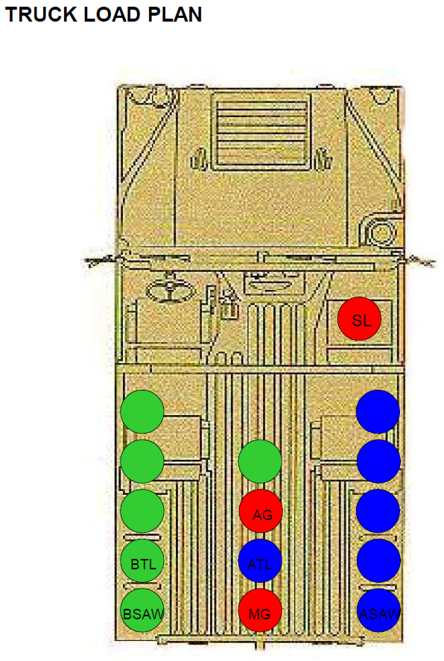
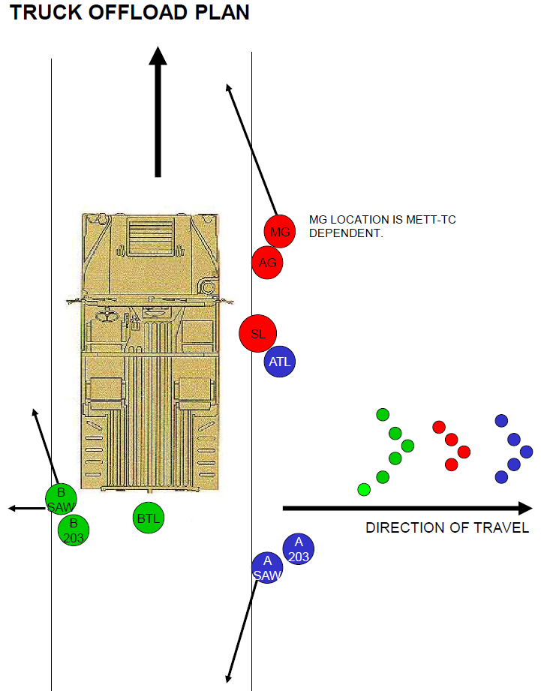
TRUCK PLAN
Venues
ANNEX

Slide 37
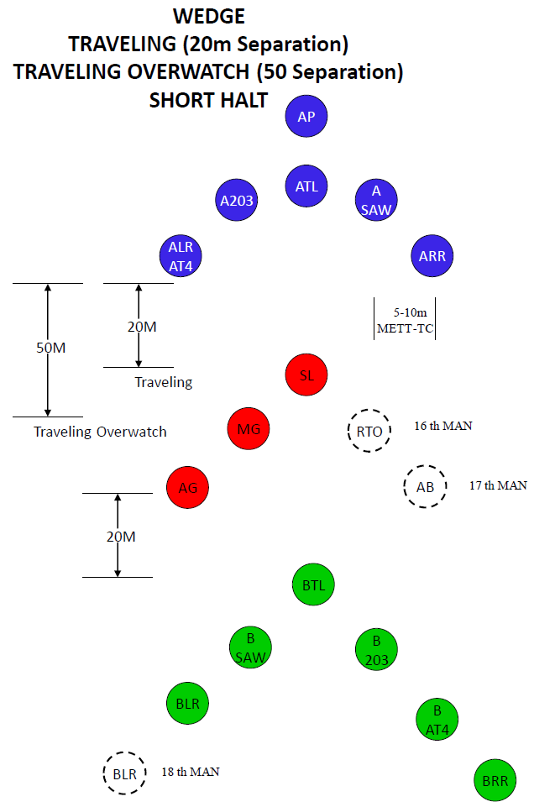
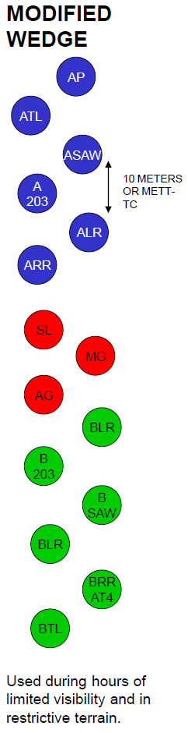
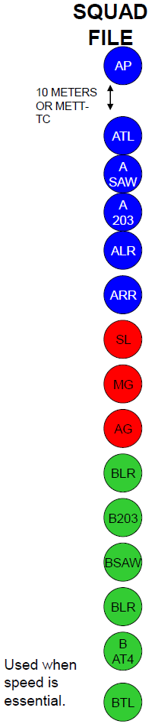
FORMATIONS
Venues
ANNEX

Slide 38
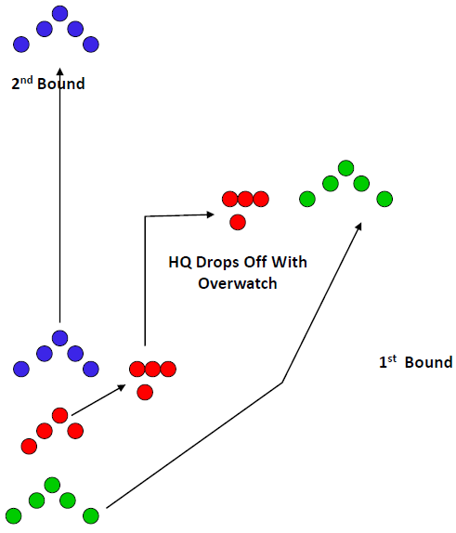
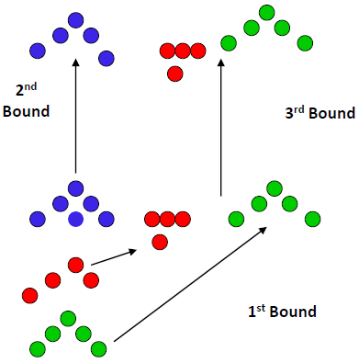
BOUNDING
Venues
ANNEX
ALTERNATING
SUCCESSIVE

Slide 39
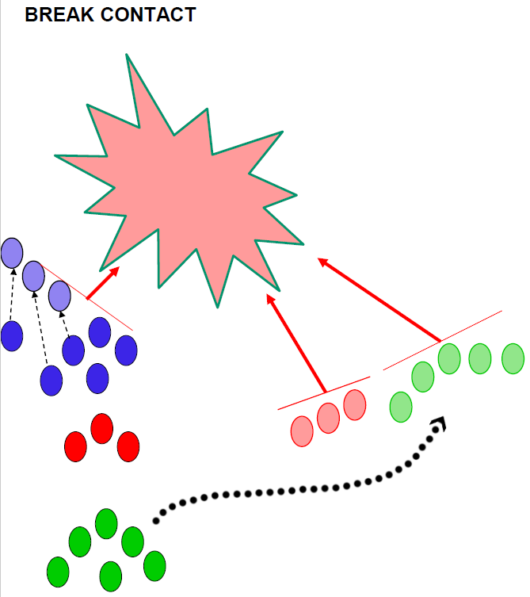
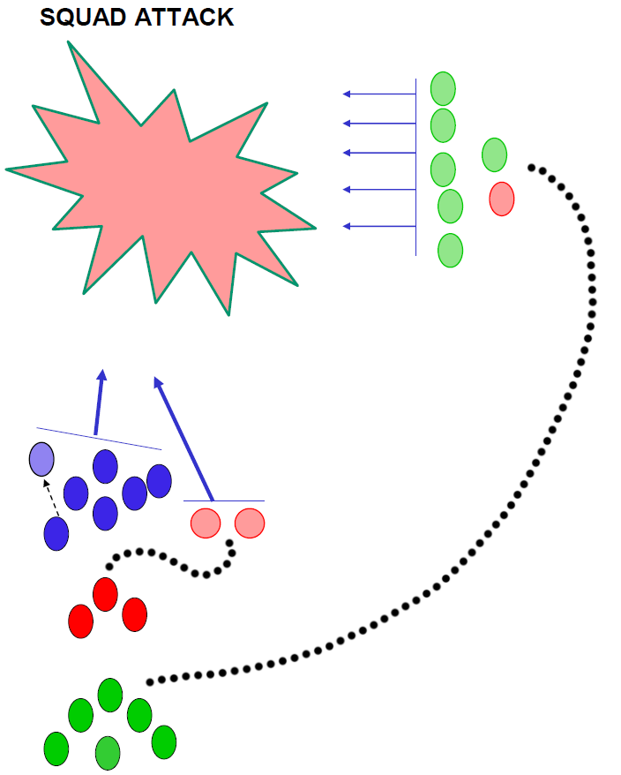
FORMATIONS
Venues
ANNEX

Slide 40












CASUALTY CARRY
ANNEX
CASUALTY

Slide 41
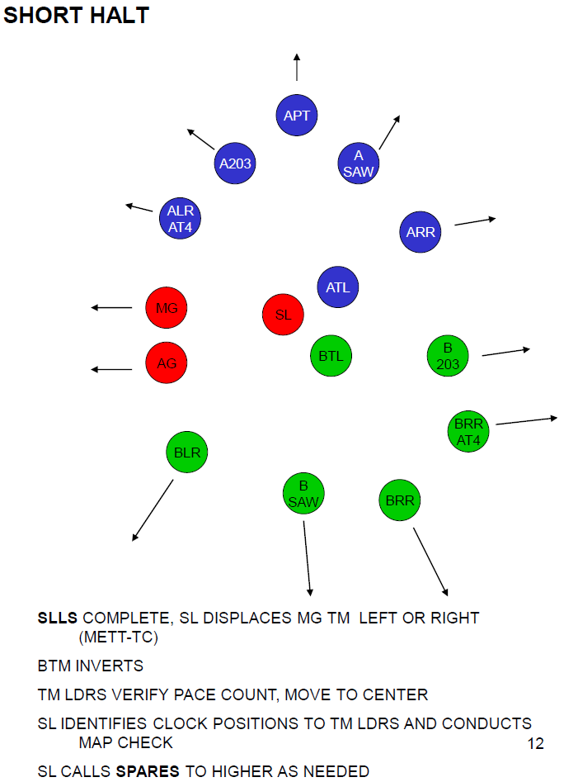
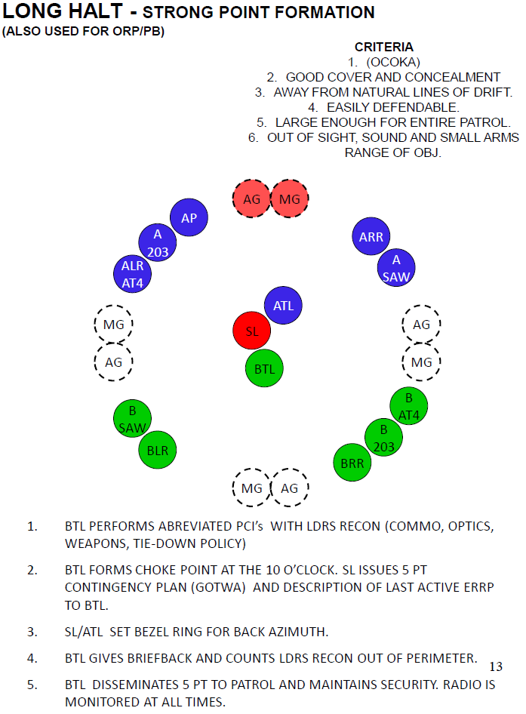
HALTS
Venues
ANNEX

Slide 42
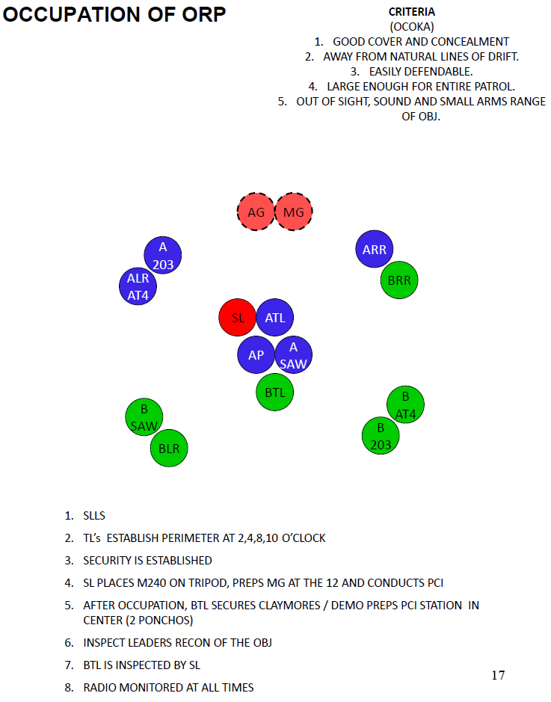
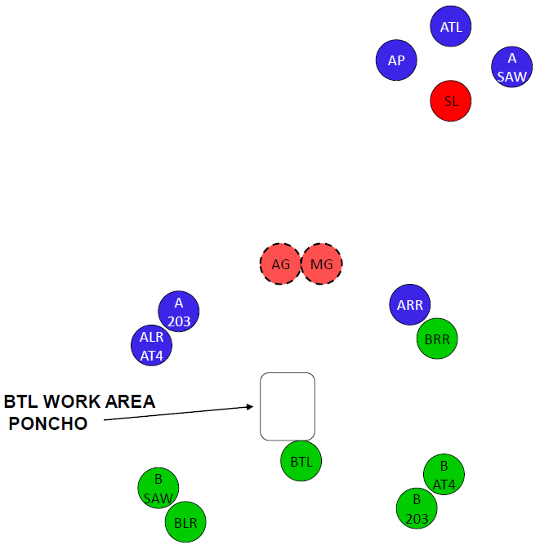
ORP
Venues
ANNEX
MWE AND LEADER’S RECON

Slide 43
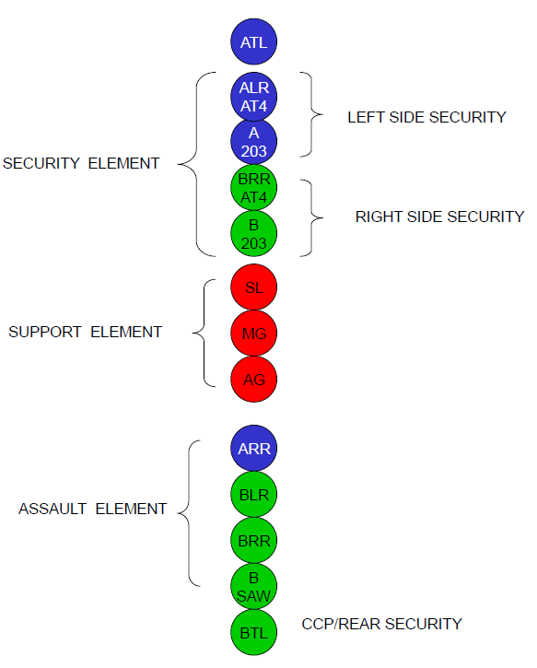
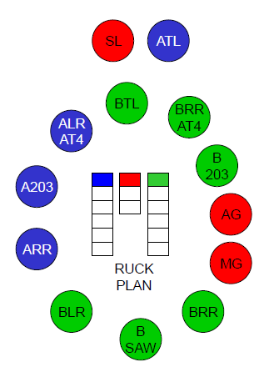
RELEASE POINT
Venues
ANNEX
RUCK PLAN AT RP
OOM FROM RP

Slide 44
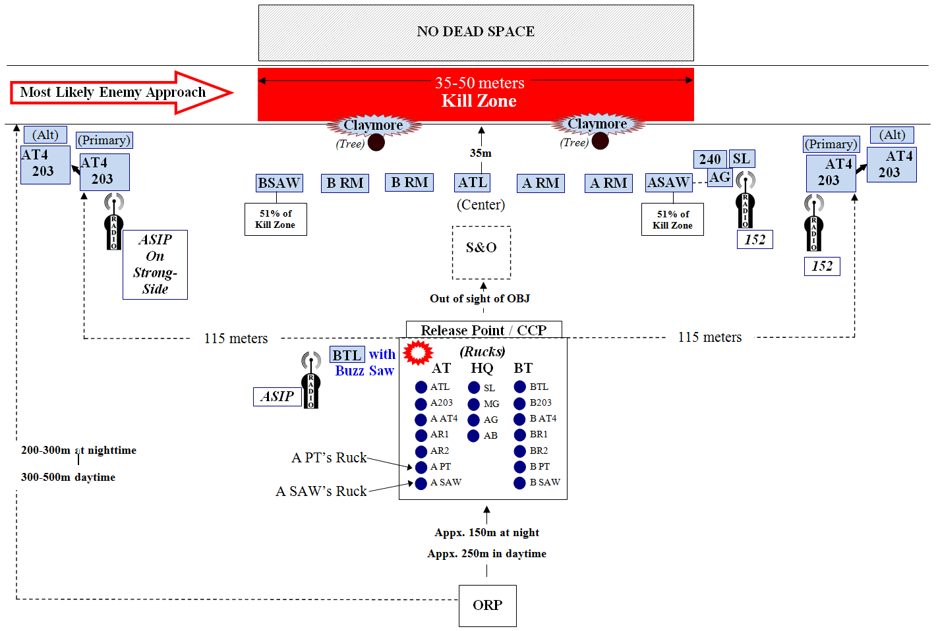
AMBUSH POSTURE
Venues
ANNEX

Slide 45
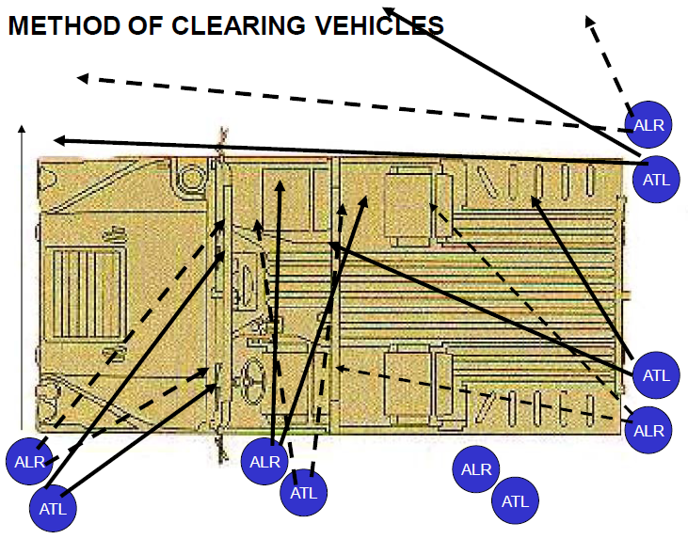
CLEARING A VEHICLE
Venues
ANNEX

Slide 46
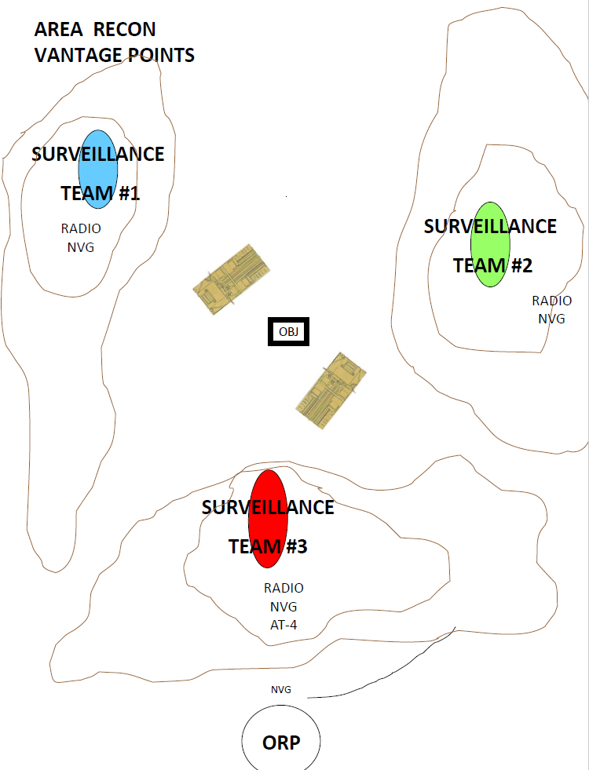
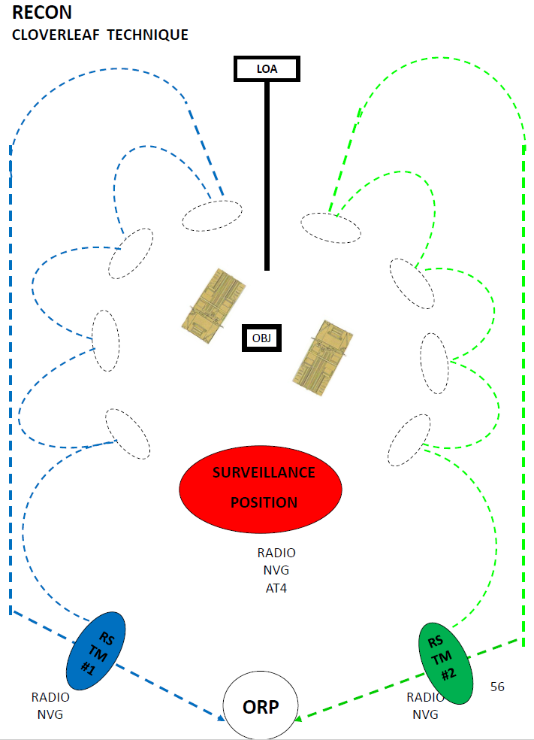
RECONNAISSANCE
Venues
ANNEX

Slide 47
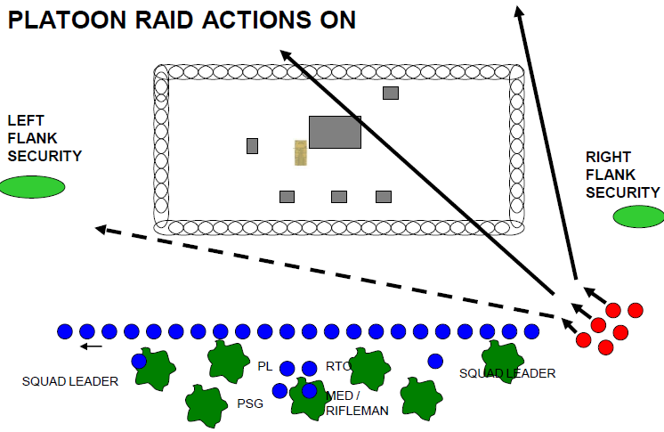
RAID POSTURE
Venues
ANNEX

Slide 48
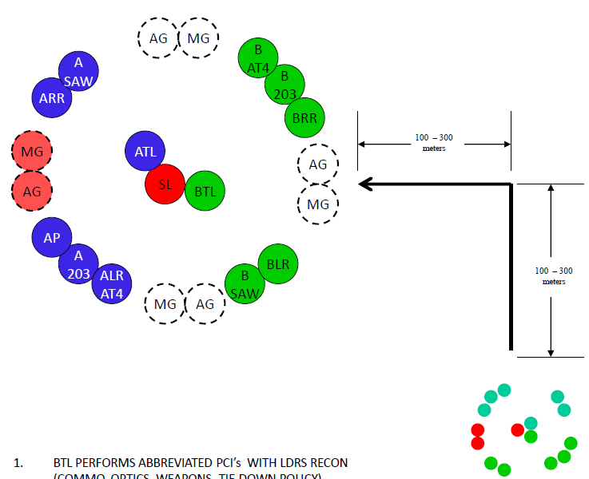
PATROL BASE – ENEMY CONTACT NOT LIKELY/NOT FOLLOWED/SUMMER
ANNEX
Venues

Slide 49
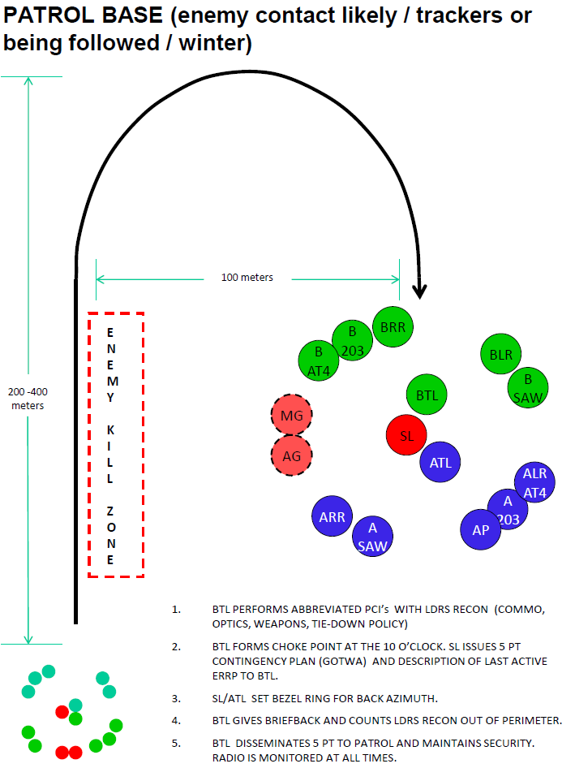
PATROL BASE – ENEMY CONTACT LIKELY/FOLLOWED/SUMMER
Venues
ANNEX

